Slide 1

ASSIGNMENT - 2
Done By
T.V.Thirisa
C.Priya
V.Priyadharshini
M.Sarumathy

Slide 2
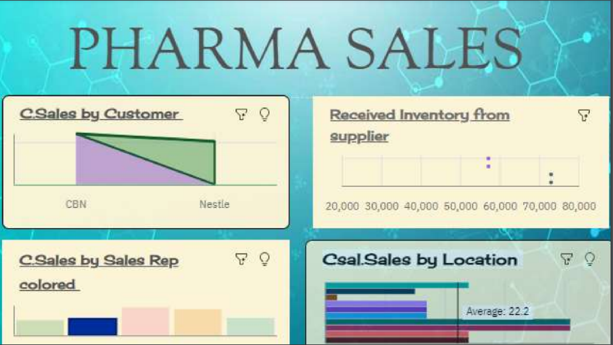

Slide 3
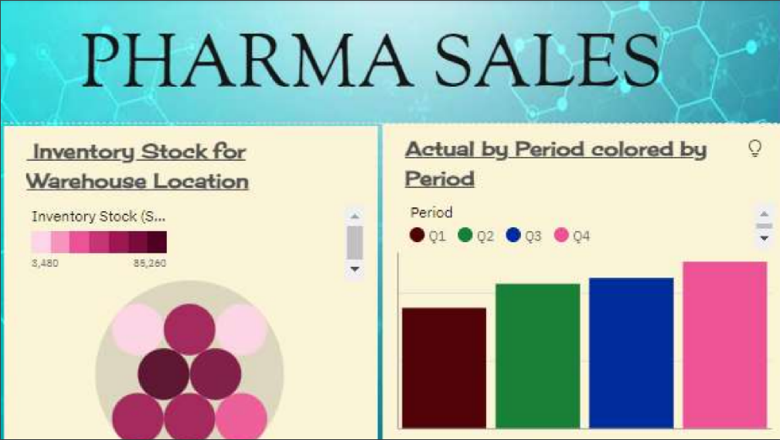

Slide 4
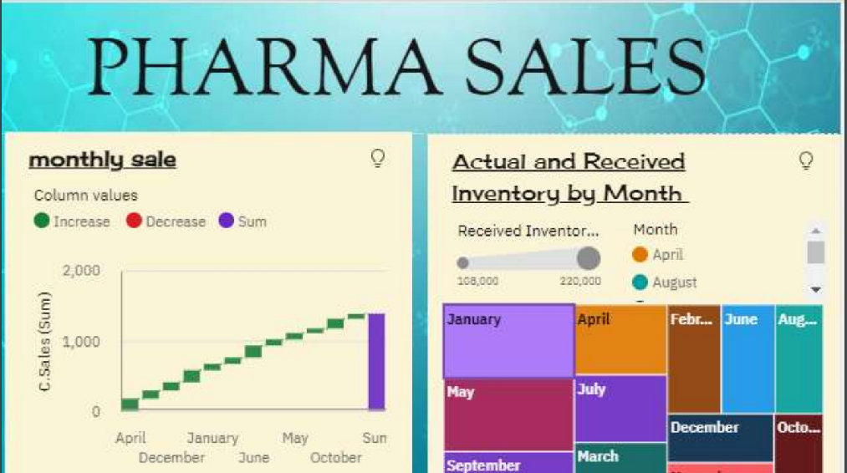

Slide 5
THANK YOU

